Slide 1

Bell Work: Solve
$${1.) 5(3)}^{6x−12}+12=32$$
$${2.) 4log}_{2}\left(2x+9\right)−21=3$$

Slide 2
From Last Time
Page 251 # 13, 15, 19, 23, 29, 35, 38, 63, 67, 87, 97, 129

Slide 3
Pre-calc trig
Day 26

Slide 4
3.5 Exponential and Log Models
Objectives: To apply and solve real life problems involving exponential and logarithmic equations

Slide 5
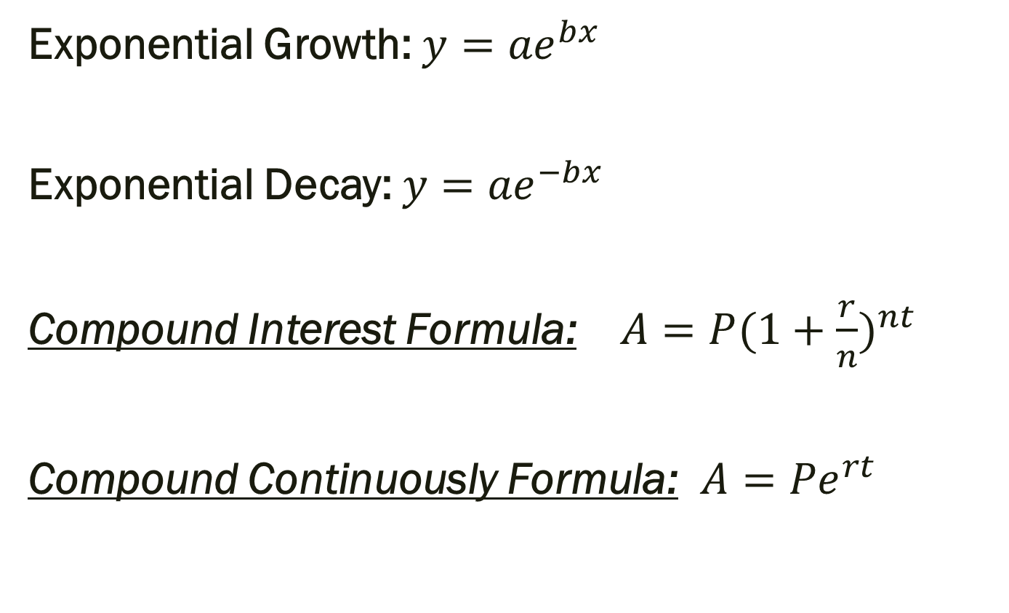
Formulas
Exponential Growth:${y=ae}^{bx}$
Exponential Decay: ${y=ae}^{−bx}$
Compound Interest Formula: $A={P(1+\frac{r}{n})}^{nt}$
Compound Continuously Formula: $A={Pe}^{rt}$

Slide 6
Example
You have $200 to deposit. Your bank has two options for your investment. You can either put it into an account with 5.2% interest compounded continuously or an account with 5.6% compounded monthly. How long will it take for each account to triple your money, and which account are you more likely to pick? Why?

Slide 7
For Next Time
Page 262 #15, 17, 21, 43, 59, 61

